Slide 1

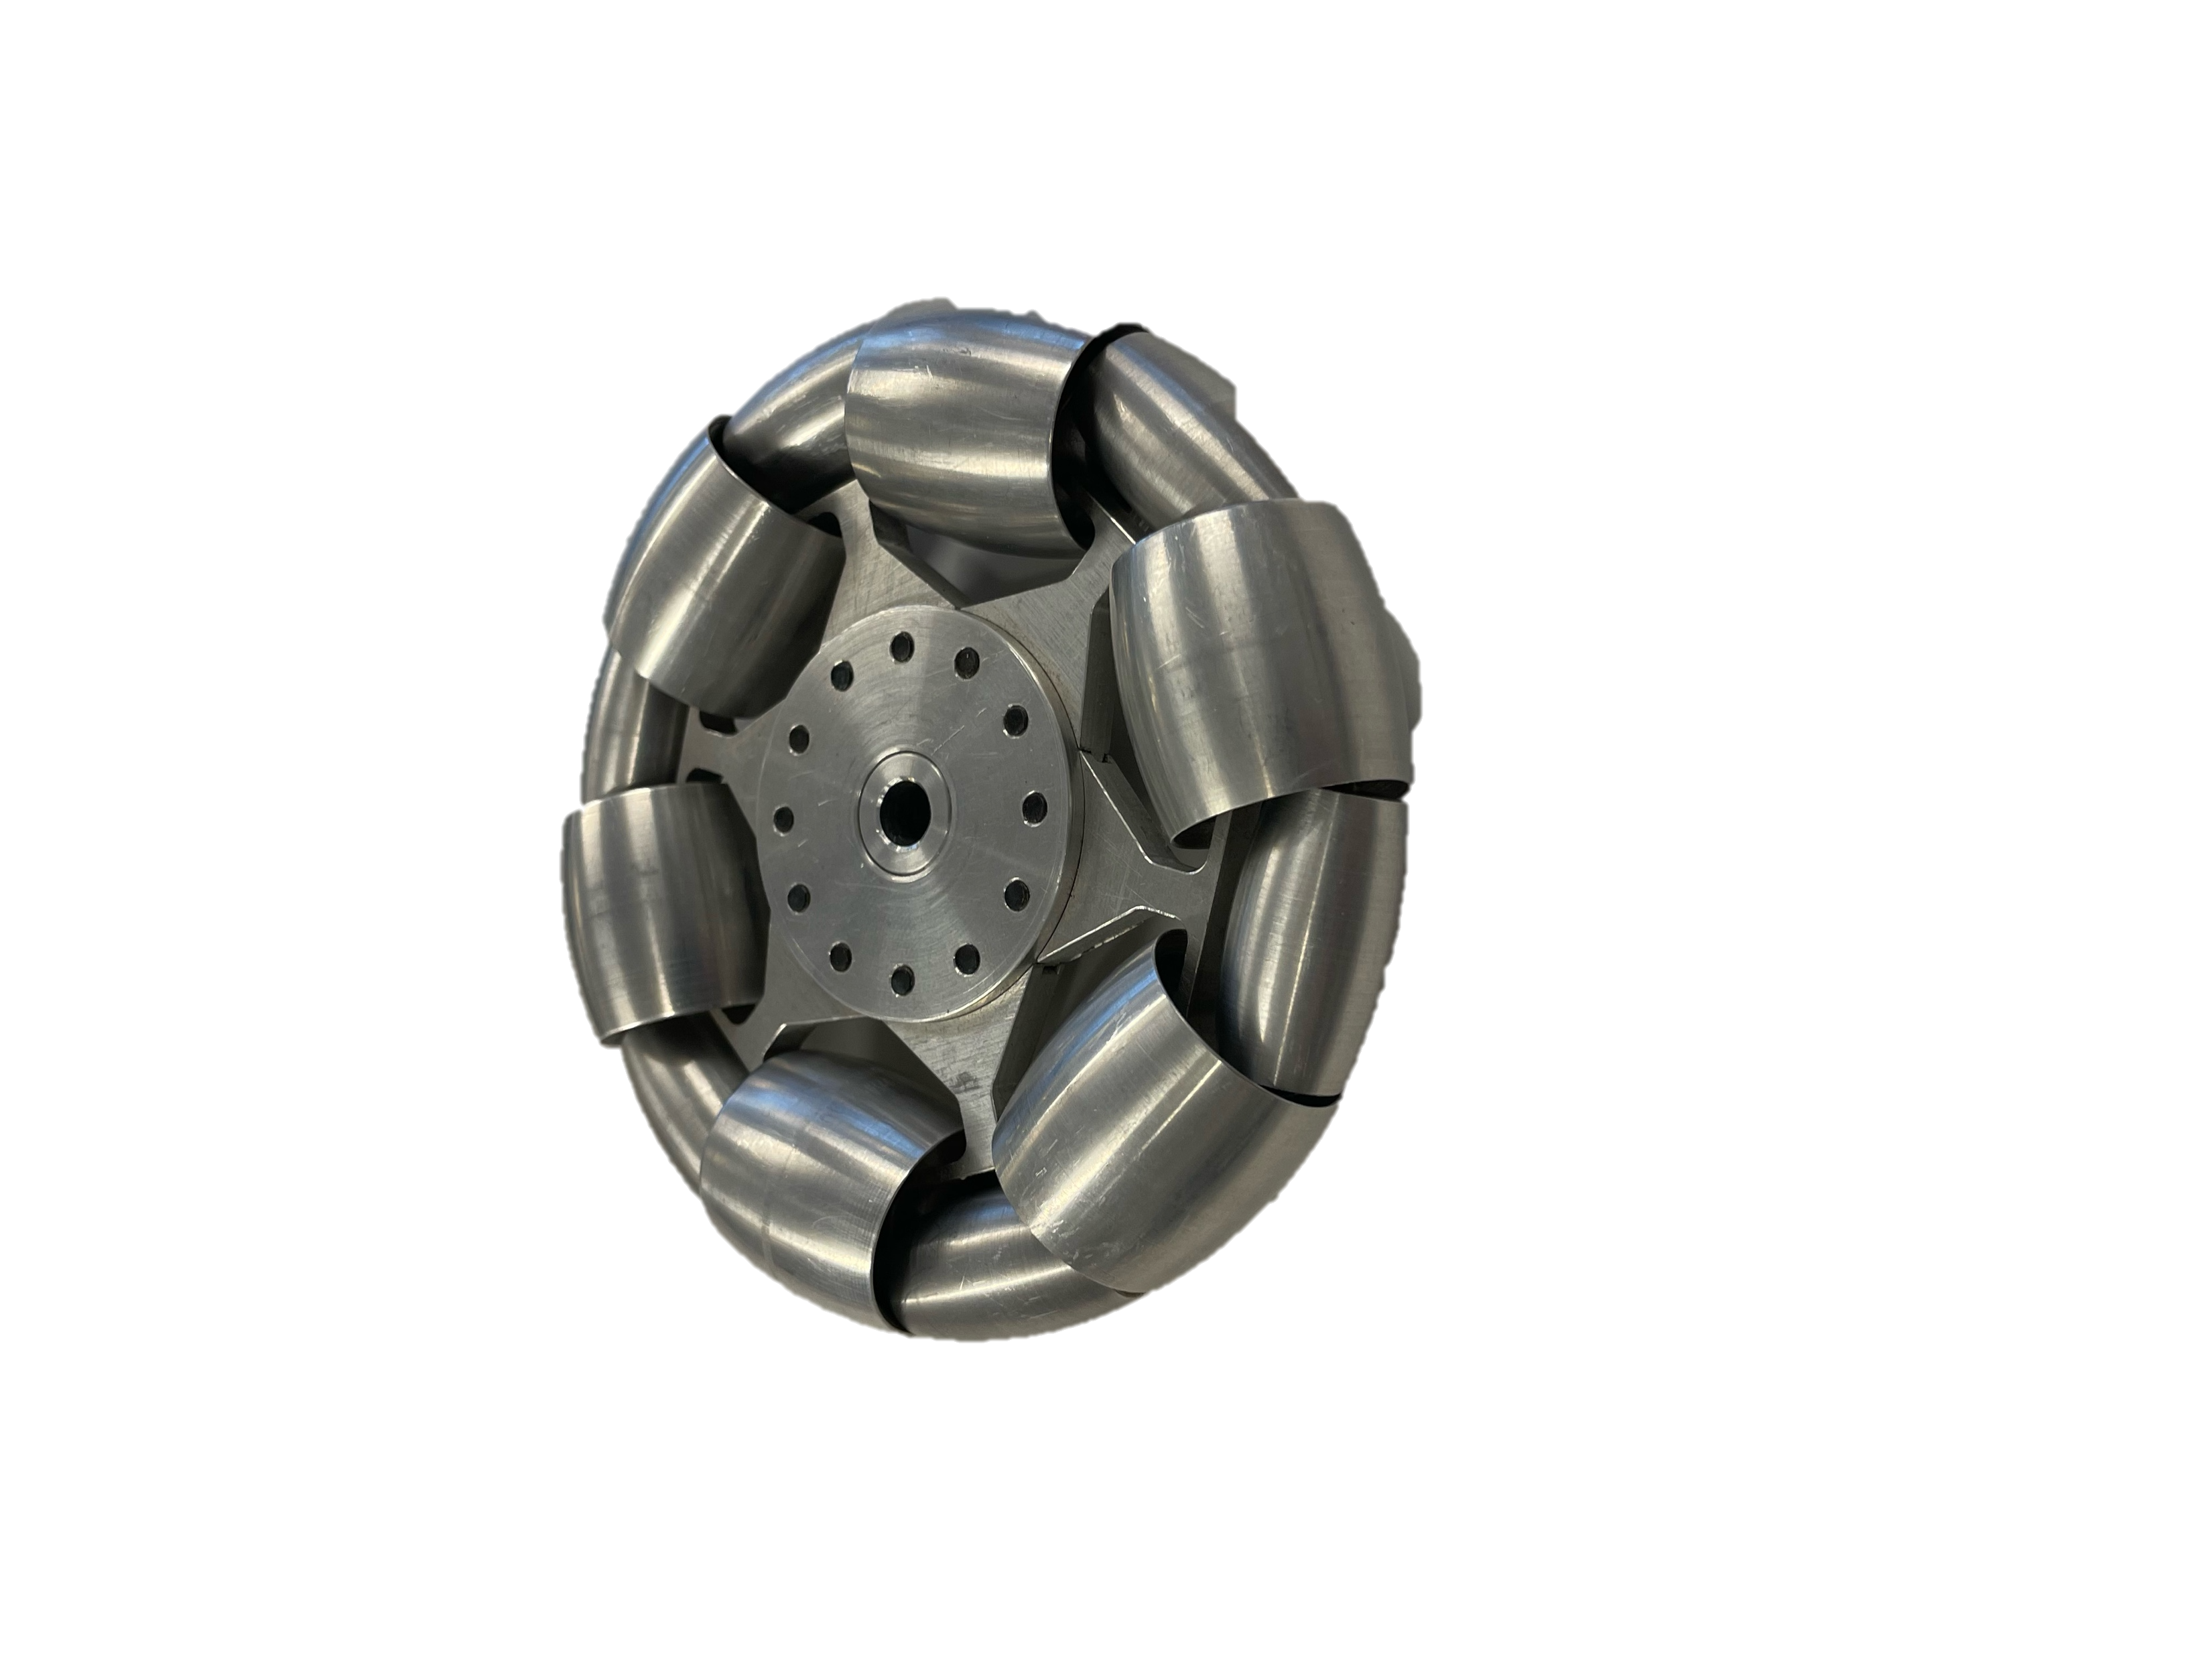
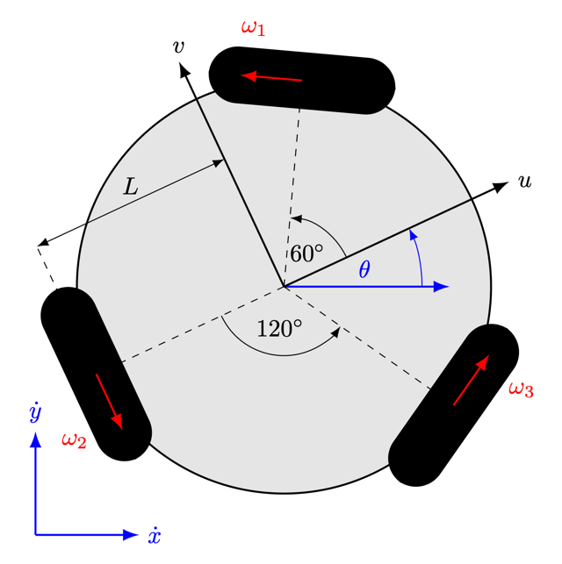
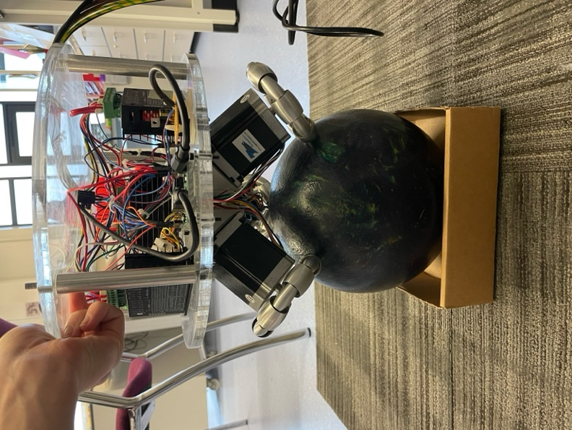
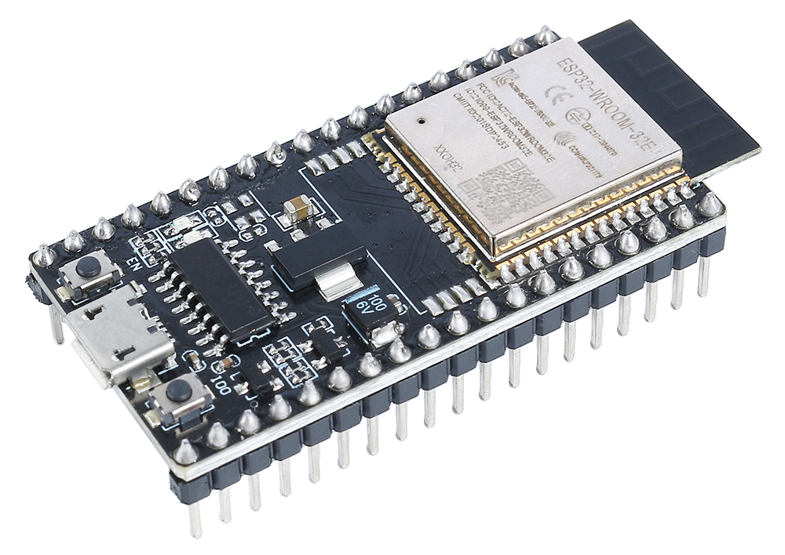
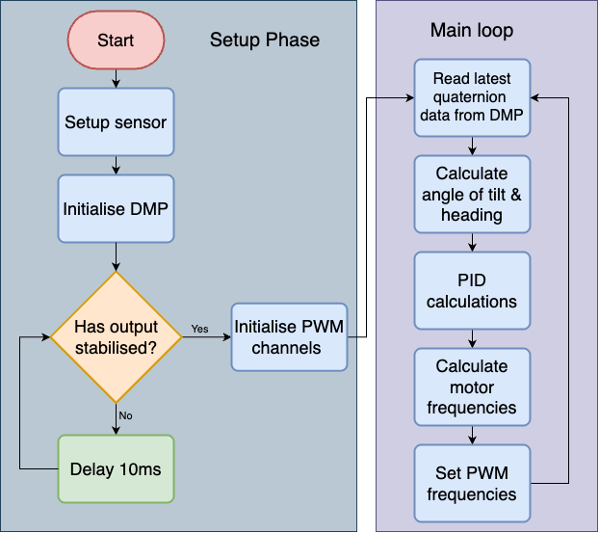
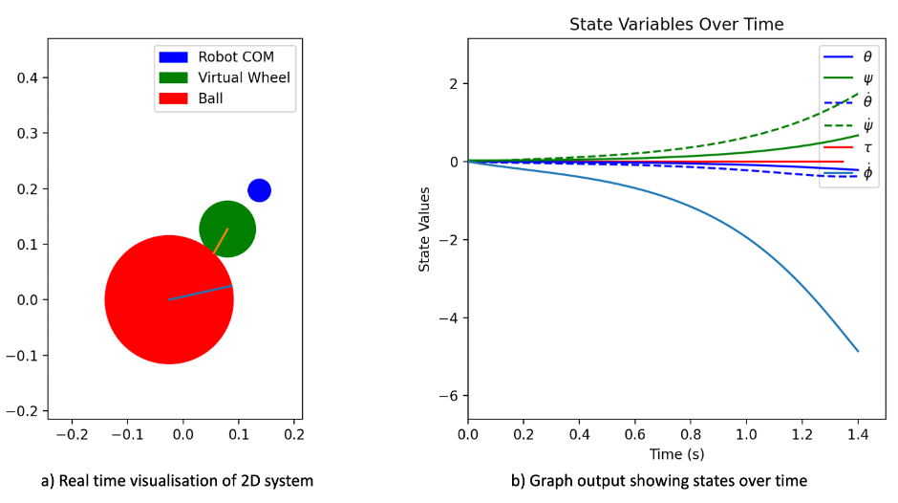
Control system to balance a robot on a moving sphere
Orientation Sensing
IMU (Inertial Measurement Unit) needed extra firmware only available with microcontrollers with greater memory capacity.
Outputs quaternions to be turned into orientation vector.
Accuracy of measurements remained within ±2.5° of actual angles.
Background
The robot below was provided by a previous student project
Includes three omni wheels and three large stepper motors, each with accompanying drivers
It suffered from some hardware limitations were resolved throughout the project
Omni-directional wheels -->
Inverse kinematics were computed to drive wheels at correct speeds
Variable PWM control used to operate motors at responsive varying speeds
Simulation
A 2D simulation was developed to assess different control techniques and learn about the dynamics
Microcontroller was upgraded to an ESP32 for faster speeds and more memory
Basic controller was implemented and it balanced !
Benjamin Bolton F223612
Meng RMCE
Wolfson School of Mechanical, Electrical and Manufacturing Engineering

